Slide 1
Achieving Quality
Software Design & Architecture

Slide 2
Introduction
Certain architectural decisions enable an architect to achieve the desired quality attribute requirements
Our interest here is in these design decisions or tactics.
A tactic is a design decision that influences the control of a quality attribute response
A collection of tactics is called an architectural strategy

Slide 3
Tactics
Each tactic is a design option for the architect
A system design consists of a collection of decisions
  Some control quality control responses
  Others help to achieve system functionality
Influences of tactics can be:
  Tactics can refine other tactics
  Patterns package tactics
Organize tactics for each quality attribute as a hierarchy

Slide 4
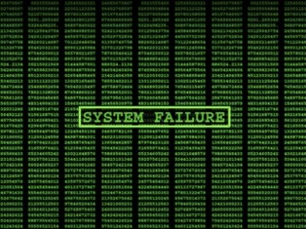

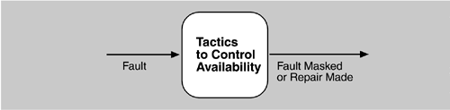
Availability tactics
A failure occurs when the system no longer delivers a service that is consistent with its specification
A fault (or combination of faults) has the potential to cause a failure
recovery or repair is an important aspect of availability

Slide 5
Availability tactics …
Think of a major feature present in the Windows XP related to recovery?
Many of the tactics are available in the standard execution environments, i.e. operating systems, application servers, and database management systems
Availability involves redundancy, health monitoring to detect a failure and of recovery when a failure is detected

Slide 6
Availability
Fault Detection
Fault Recovery
Fault Prevention

Slide 7
Fault Detection
Three widely used methods are:
  ping/echo, heartbeat and exceptions
Ping/Echo
  One component issues a ping and expects to receive back an echo, within a predefined time, from the component under scrutiny
    Client to the server, a group of components performing some task together

Slide 8
Fault Detection .. 2
Heartbeat (dead man timer)
  In this case one component emits a heartbeat message periodically and another component listens for it.
  The heartbeat can also carry data
Exceptions
  An exception is raised when one of the faulty classes is recognized
  The exception handler typically executes in the same process that introduced the exception.

Slide 9
FAULT RECOVERY
Fault recovery consists of preparing for recovery and making the system repair
Methods are:
  Voting
    Processes running on redundant processors each take equivalent input and compute a simple output value that is sent to a voter
    If the voter detects deviant behaviour from a single processor, it fails it.
    Used to correct faulty operation of algorithms or failure of a processor and is often used in control systems

Slide 10
Active redundancy (hot restart).
All redundant components respond to events in parallel.
Consequently, they are all in the same state
The response from only one component is used (usually the first to respond) discarding the rest
Active redundancy is often used in a client/server configuration, such as database management systems, where quick responses are necessary even when a fault occurs.
Synchronisation … ?

Slide 11
Passive redundancy
Also called (warm restart/dual redundancy/triple redundancy)
One component (the primary) responds to events and informs the other components (the standbys) of state updates they must make.
When a fault occurs, the system must first ensure that the backup state is sufficiently fresh before resuming services.
Forcing switchovers periodically—for example, once a day or once a week—increases the availability of the system.
Synchronization is the responsibility of the primary component

Slide 12
More tactics for FAULT RECOVERY
Spare
  A standby spare computing platform is configured to replace many different failed components.
Shadow operation.
  A previously failed component may be run in "shadow mode" for a short time to make sure that it mimics the behavior of the working components before restoring it to service.
State resynchronization
  The passive and active redundancy tactics require the component being restored to have its state upgraded before its return to service.
Checkpoint/rollback
  A checkpoint is a recording of a consistent state created either periodically or in response to specific events.

Slide 13
FAULT PREVENTION
Removal from service
  This tactic removes a component of the system from operation to undergo some activities to prevent anticipated failures
  One example is rebooting a component to prevent memory leaks from causing a failure
Transactions
  A transaction is the bundling of several sequential steps such that the entire bundle can be undone at once
Process monitor
  A monitoring process can delete the faulty process and create a new instance of it, initialized to some appropriate state

Slide 14
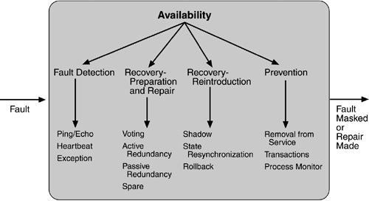

Slide 15
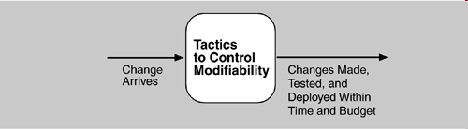
Modifiability tactics
Modifiability’s main goal is controlling the time and cost to implement, test, and deploy changes.
We organise the modifiability tactics into three groups:
  localize modifications: reduce the number of modules that are directly affected by a change.
  prevent the ripple effect: limiting modifications to the localized modules
  defer binding time: controlling deployment time and cost.

Slide 16
LOCALIZE MODIFICATIONS
Restricting modifications to a small set of modules will generally reduce the cost
  Maintain semantic coherence
    Semantic coherence refers to the relationships among responsibilities in a module
    the goal is to ensure that all of these responsibilities work together without excessive reliance on other modules
    One way of achieving or measuring this is coupling and cohesion
    But they lack context of a change
    Set of anticipated changes

Slide 17
LOCALIZE MODIFICATIONS …
Maintain semantic coherence …
  abstract common services: provide through specialised modules
    Use of application frameworks and the use of other middleware software.
Anticipate expected changes
  The tactic of anticipating expected changes is concerned with minimizing the effects of the changes
  Normally used in conjunction with semantic coherence

Slide 18
LOCALIZE MODIFICATIONS …
Limit possible options
  Restricting the possible options will reduce the effect of these modifications
    Restricting processor changes to members of the same family limits the possible options.

Slide 19
DEFER BINDING TIME
With the previous two techniques we can not reduce time to deploy
Also support to make changes by non-developers is required
Late binding can support above two features
Two kind of binding are important
  Deployment time bindings
  Run-time bindings

Slide 20
DEFER BINDING TIME …
Developer’s modifications follow a process i.e., changes, testing and distribution
  Incurs a time lag between making the changes and when these changes will be available to the user
In runtime binding, the system is prepared for that binding
The end user or administrator can make the changes and the changes are visible

Slide 21
DEFER BINDING TIME .. Tactics
Runtime registration
  supports plug-and-play operation
  additional overhead to manage the registration
  Publish/subscribe registration, for example, can be implemented at either runtime or load time
Configuration files
  set parameters at startup
  i.e., Apache server configuration file
Polymorphism
  allows late binding of method calls.

Slide 22
DEFER BINDING TIME .. Tactics
Component replacement
  load time binding
Adherence to defined protocols
  runtime binding of independent processes

Slide 23
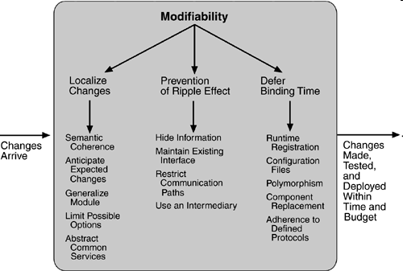

Slide 24
Performance Tactics
goal of performance tactics is to generate a response to an event arriving at the system within some time constraint
The event can be single or a stream and is the trigger for a request to perform computation
  arrival of a message
  the expiration of a time interval
  the detection of a significant change of state in the system's environment

Slide 25
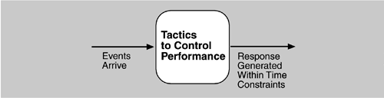
resource consumption
  An event goes through various steps of process each consuming some sort of a resource (i.e. CPU, bandwidth, an entity etc.)
  Each phase contributes to the overall latency of the processing of that event.
  a message is generated by one component, is placed on the network, and arrives at another component. It is then placed in a buffer; transformed in some fashion (marshalling is the term the Object Management Group uses for this transformation); processed according to some algorithm; transformed for output; placed in an output buffer; and sent onward to another component, another system, or the user.

Slide 26
Blocked time
A computation can be blocked from using a resource because of
  contention for it
  the resource is unavailable
  the computation depends on the result of other computation which is not yet available

Slide 27
Tactics for performance
RESOURCE DEMAND
Event streams are the source of demand
  how often a request is made in a stream
  how much of a resource is consumed by each request
Solution: Reduce the resource required
  Increase computational efficiency
    Improve algorithms to decrease latency
  Reduce computational overhead
    no request for a resource, less processing needs
    Use of Java classes instead of RMI
    Remove intermediary to reduce processing of an event

Slide 28
RESOURCE DEMAND …
Solution: Reduce the no of events processed
  Manage event rate
    Reduce the sampling frequency at which certain variables are being monitored
  Control frequency of sampling
    queued requests can be sampled at a lower frequency
Other ways
  Bound execution times
  Bound queue sizes

Slide 29
RESOURCE MANAGEMENT
Introduce concurrency
  Process requests in parallel to reduce block time
  Process streams of events on different threads
  Load balancing is required
Maintain multiple copies of either data or computations
  Caching is a tactic in which data is replicated in different repositories
  Reduces contention
  Consistency and synchronisation of data is an issue
Increase available resources.

Slide 30
RESOURCE ARBITRATION
Schedule resources to avoid contention for a resources
A scheduling policy has two parts
  a priority assignment and dispatching
Scheduling policies can be:
  First-in/First-out
  Fixed-priority scheduling
  Dynamic priority scheduling
  Static scheduling

Slide 31
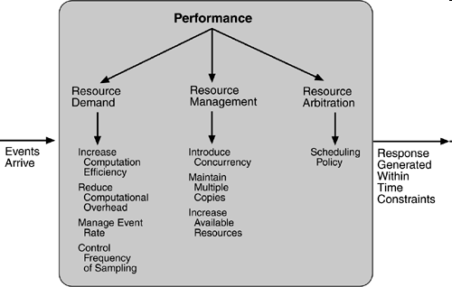

Slide 32
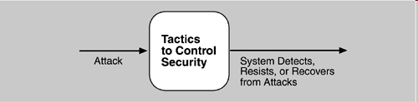
Security Tactics
Three aspects of security
  resisting attacks
  detecting attacks
  recovering from attacks

Slide 33
RESISTING ATTACKS
nonrepudiation, confidentiality, integrity, and assurance are the goals in our security characterization
  Authenticate users
    Authentication is ensuring that a user or remote computer is actually who it purports to be
    Passwords, one-time passwords, digital certificates, and biometric identifications provide authentication
  Authorize users
    To ensure that an authenticated user has the rights to access and modify either data or services
    access control patterns

Slide 34
RESISTING ATTACKS …
Maintain data confidentiality
  Encryption of data and communication links
  virtual private network (VPN), Secure Sockets Layer (SSL), encryption keys
Maintain integrity
  Data should be delivered as intended
  checksums or hash results
Limit exposure and access
  Attacks typically depend on exploiting a single weakness to attack all data and services on a host
  allocation of services to hosts so that limited services are available on each host.
  Use of firewalls to limit access

Slide 35
DETECTING ATTACKS
an intrusion detection system
comparing network traffic patterns to a database
Intrusion detectors should have
  some sensor to detect attacks
  managers to do sensor fusion
  databases for storing events for later analysis
  tools for offline reporting and analysis
  a control console so that the analyst can modify intrusion detection actions.

Slide 36
RECOVERING FROM ATTACKS
Tactics involved are related with
  restoring state and
  those concerned with attacker identification (for either preventive or punitive purposes)
Tactic for restoring state overlap with that of availability
maintaining redundant copies of system administrative data such as passwords, access control lists, domain name services, and user profile data.

Slide 37
RECOVERING FROM ATTACKS
The tactic for identifying an attacker is to maintain an audit trail
Maintain a copy of each transaction applied to the data in the system together with identifying information
Helps in tracking the actions of an attacker, non-repudiation and system recovery

Slide 38
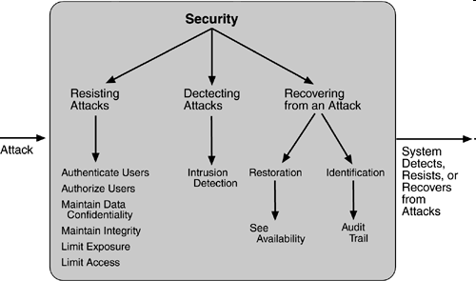
Security Tactics

Slide 39
Testability Tactics
The goal is to allow for easier testing when an increment of software development is completed
The goal of a testing regime is to discover faults
test harness
  Executing the test procedures requires some software to provide input to the software being tested and to capture the output.
Two tactics are providing input and capturing output, and internal monitoring

Slide 40
INPUT/OUTPUT
Record/playback
  Record/playback refers to both capturing information crossing an interface and using it as input into the test harness
  The information crossing an interface during normal operation is saved in some repository
  represents output from one component and input to another
  Recording this information allows test input for one of the components to be generated and test output for later comparison to be saved.

Slide 41
INPUT/OUTPUT …
Separate interface from implementation
  Separating the interface from the implementation allows substitution of implementations for various testing purposes
  Stubbing implementations allows the remainder of the system to be tested in the absence of the component being stubbed
  Substituting a specialized component allows the component being replaced to act as a test harness for the remainder of the system.

Slide 42
INPUT/OUTPUT …
Specialize access routes/interfaces
  Develop specialised testing interfaces allows the capturing or specification of variable values for a component through a test harness as well as independently from its normal execution.
  Specialized access routes and interfaces should be kept separate from the access routes and interfaces for required functionality.

Slide 43
INTERNAL MONITORING
Built-in monitors
  The component can maintain state, performance load, capacity, security, or other information accessible through an interface
  This interface can be a permanent interface of the component or it can be introduced temporarily via an instrumentation technique
  A common technique is to record events when monitoring states have been activated
  Increased visibility into the activities of the component outweighs the cost of the additional testing

Slide 44
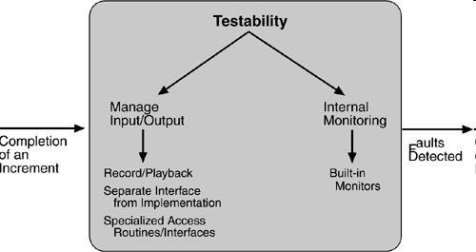
Testability Tactics

Slide 45
Usability Tactics
usability is concerned with how easy it is for the user to accomplish a desired task
Also, the kind of support the system provides to the user
Two types of categories of tactics
  The first category, runtime, includes those that support the user during system execution
  The second category is based on the iterative nature of user interface design and supports the interface developer at design time
  The latter is strongly related to the modifiability tactics

Slide 46
Usability Tactics – Runtime tactics
Three aspects of HCI
  "user initiative” i.e., when cancelling a command the user issues a cancel
  "system initiative” i.e., during the cancel, the system may put up a progress indicator
  Thus, cancel demonstrates "mixed initiative"
Maintain a model of the task
  The task model is used to determine context For example, knowing that sentences usually start with capital letters would allow an application to correct a lower-case letter in that position.

Slide 47
Usability Tactics – Runtime tactics
2) Maintain a model of the user
  It determines the user's knowledge of the system, the user's behavior in terms of expected response time, and other aspects specific to a user or a class of users
    For example, maintaining a user model allows the system to pace scrolling so that pages do not fly past faster than they can be read.
3) Maintain a model of the system
  It determines the expected system behavior so that appropriate feedback can be given to the user
  For example, the time needed to complete current activity.

Slide 48
Usability Tactics – Design-time tactics
Separate the user interface from the rest of the application
  Localizing expected changes
    Model-View-Controller
    Presentation-Abstraction-Control

Slide 49
Further Reading and References
Chapter 5 of “Software Architecture in Practice” by Len Bass

